Slide 1

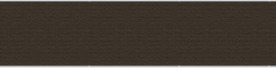
PCB DESIGNING USING EASYEDA
SUBMITTED TO :
PROF. MIKE ALESHAMS
SUBMITTED BY: SUKHMEET SIDHU (CO751457)

Slide 2

CONTENTS
PROJECT INTRODUCTION
SOFTWARE
EASY EDA
PCB DESIGNING
TROUBLESHOOTS
CONCLUSION
REFERENCES

Slide 3
IOT BASED BEAGLEBONE OPERATED PARKING SYSTEM
In modern times we need modern technology to work with the high speed demand and due this the project will see a huge impact in the near future.
We have used a beaglebone black as the main controller and it will power other supporting hardware to work according the required needs.

Slide 4
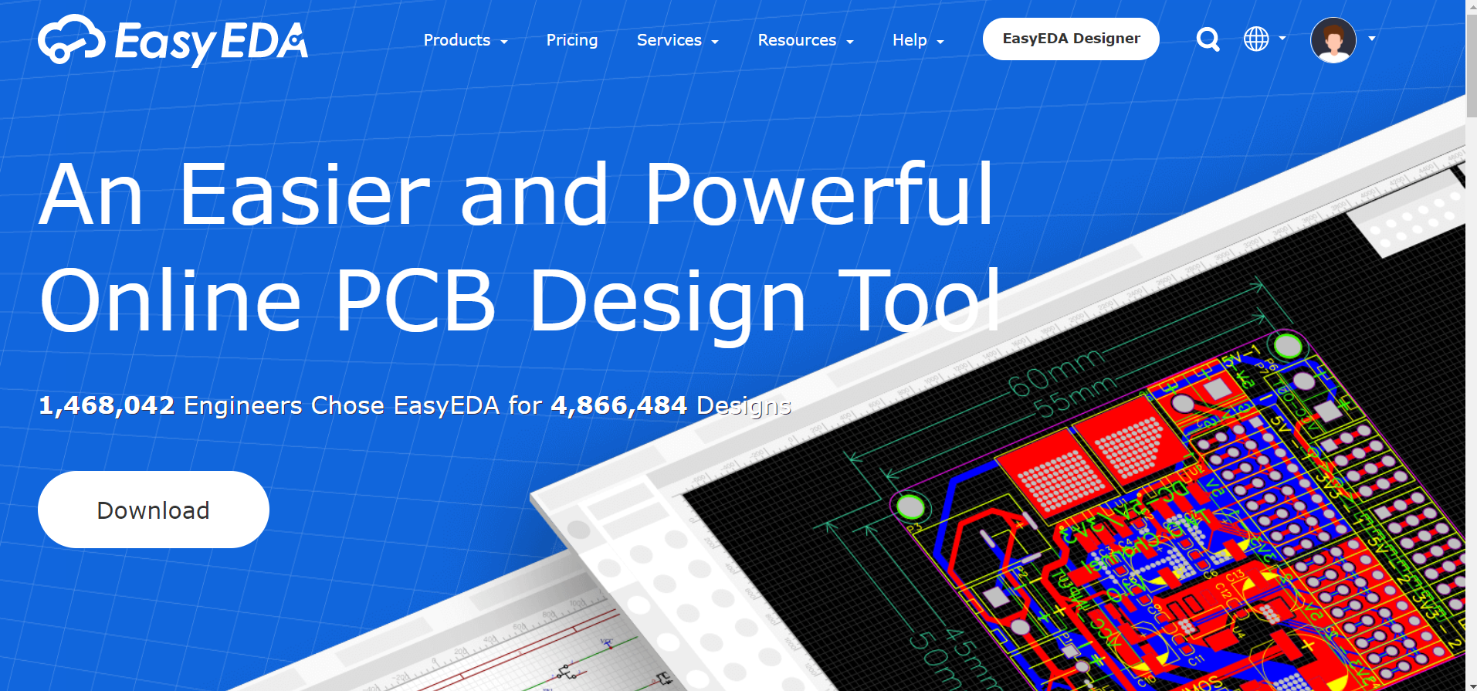
EASYEDA

Slide 5

TASK OBJECTIVE
To generate the PCB design for the IOT based SMART parking system, it is crucial to generate the required Gerber file to give it to manufacturer to fabricate the PCB for us

Slide 6

EASY EDA
Easy EDA is a powerful general design capabilities and simple tool which allows students, engineer to make schematic, PCB designs
It is integrated of LCSC components and JLCPCB PCB design that helps the users to save time and make their designs into real products
Easy EDA allows the creation and editing of schematic diagrams. They can select the components from the library in a single click
Free-membership subscription is excellent for public projects plus limited for private projects. The user can increase the private projects by paying the monthly bills of $4.9/month for professional and $9.9/month/member for enterprise
It has SPICE for circuit simulation
It supports different operating system Linux, Windows, Mac
Additionally, real-time team cooperation
The current version of Easy EDA is 6.4.7

Slide 7

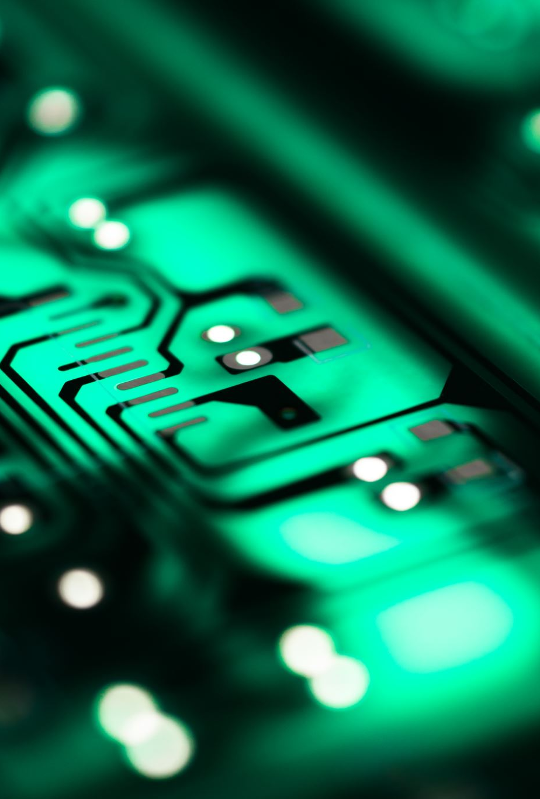
PCB DESIGNING
The most vital element in electronic circuits and equipment is the Printed Circuit Board (PCB).
It is possible to build an electronic circuit with breadboard or zero PCB, but these methods are less efficient
The invention of the PCB that supports physical electronic components and their wiring through the surface-mounted copper tracks is remarkable.

Slide 8
PCB DESIGNING
A printed circuit board (PCB) mechanically supports and electrically connects electrical or electronic components using conductive tracks
These boards are made up of special materials that do not conduct electricity such as fiber and glass
The circuits are designed on the boards with copper tracks instead of wires for the conduction of electricity between the electronic components.
The electronic components are fixed in their respective positions by drilling holes on the board, placing the components and then soldering them in appropriate positions so that the copper tracks and components together form a circuit.

Slide 9
Cont..
A PCB is made of different layers (Single layer, double layer, multiple layers) depending on the electronic component or circuit
Most of the PCB’s are 4 layer in which two inner layers are sandwiched between top and the bottom layer
Four layers are base layer, Copper layer, Solder mask, Bottom green layer

Slide 10
Depth of pc board
The base material, or substrate, is usually fiberglass. This material provides rigidity and has good heat resistance properties. Thicknesses vary from board to board usually from 0.4 to 2mm , but 1.6mm is common with designers.
The next layer is a thin copper foil, which is laminated to the board with heat and adhesive. This is the layer that conducts electricity and the circuit's components are soldered to. On common, double sided PCBs, copper is applied to both sides of the substrate.
The copper thickness can vary and is specified by weight, in ounces per square foot
The solder mask is a layer of colored resin strategically laid over the copper layer to insulate the parts of the circuit that do not get soldered to. It is overlaid onto the copper layer to insulate the copper traces from accidental contact with other metal, solder, or conductive bits. This layer helps the user to solder to the correct places and prevent solder jumpers.

Slide 11
CONT..
The white silkscreen layer is applied on top of the solder mask layer. The silkscreen adds letters, numbers, and symbols to the PCB that allow for easier assembly and indicators for humans to better understand the board.
Components are connected on the PCB : Through hole and surface mount
Through hole: Through-hole mounting is the process by which component leads are placed into drilled holes on a bare PCB.
SMT the process by which components are mounted directly onto the surface of the PCB. Known originally as “planar mounting,”

Slide 12
FLOW CHART TO DESIGN A PCB
Research the components from the library
Place the components on the Grid and make connections
Schematic capture
Convert the Schematic capture to PCB design
Resolve the troubleshoots of the missing footprint of the components
Customize the PCB design layout
Auto routing
Verification and validation
Create a Gerber file

Slide 13
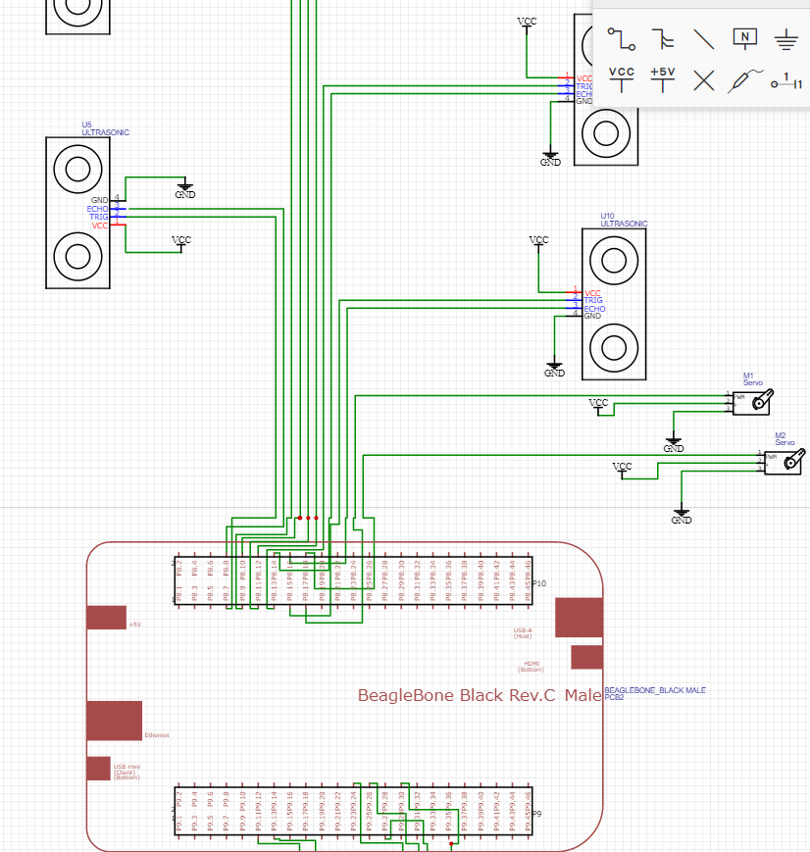

Slide 14
STEPS TO DESIGN PCB
Once the schematic is ready, then we can convert it into the PCB
Try resolving issues with footprints.
To resolve this issue, we must design again with the components having footprints already available in the user contribution library

Slide 15
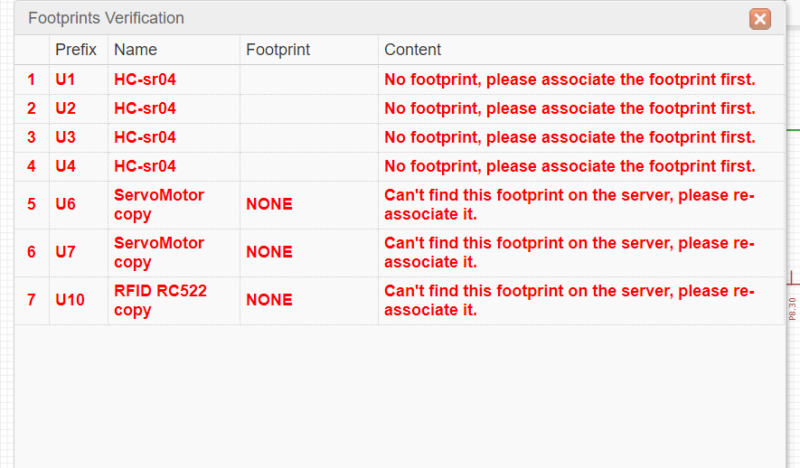
ERRORS OF THE FOOTPRINT

Slide 16
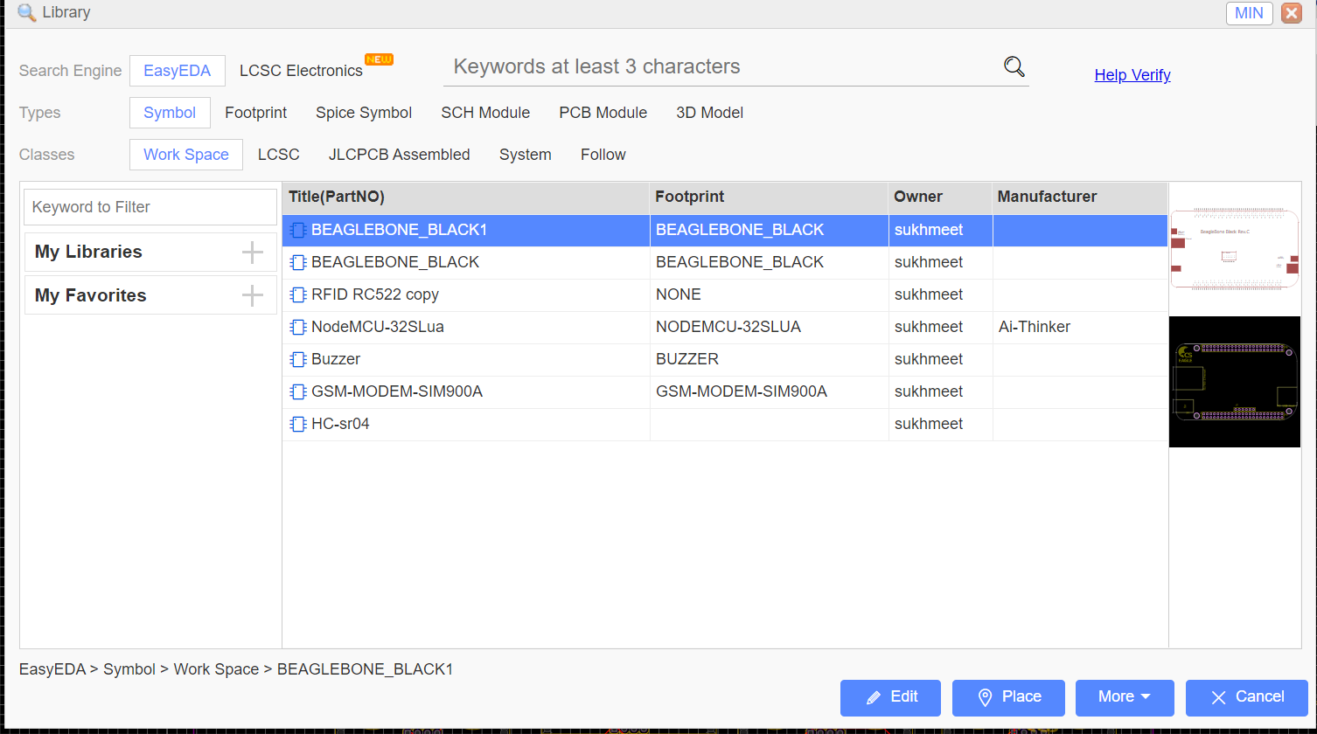
COMPONENT LIBRARY
Schematic symbol
Footprint of the component

Slide 17
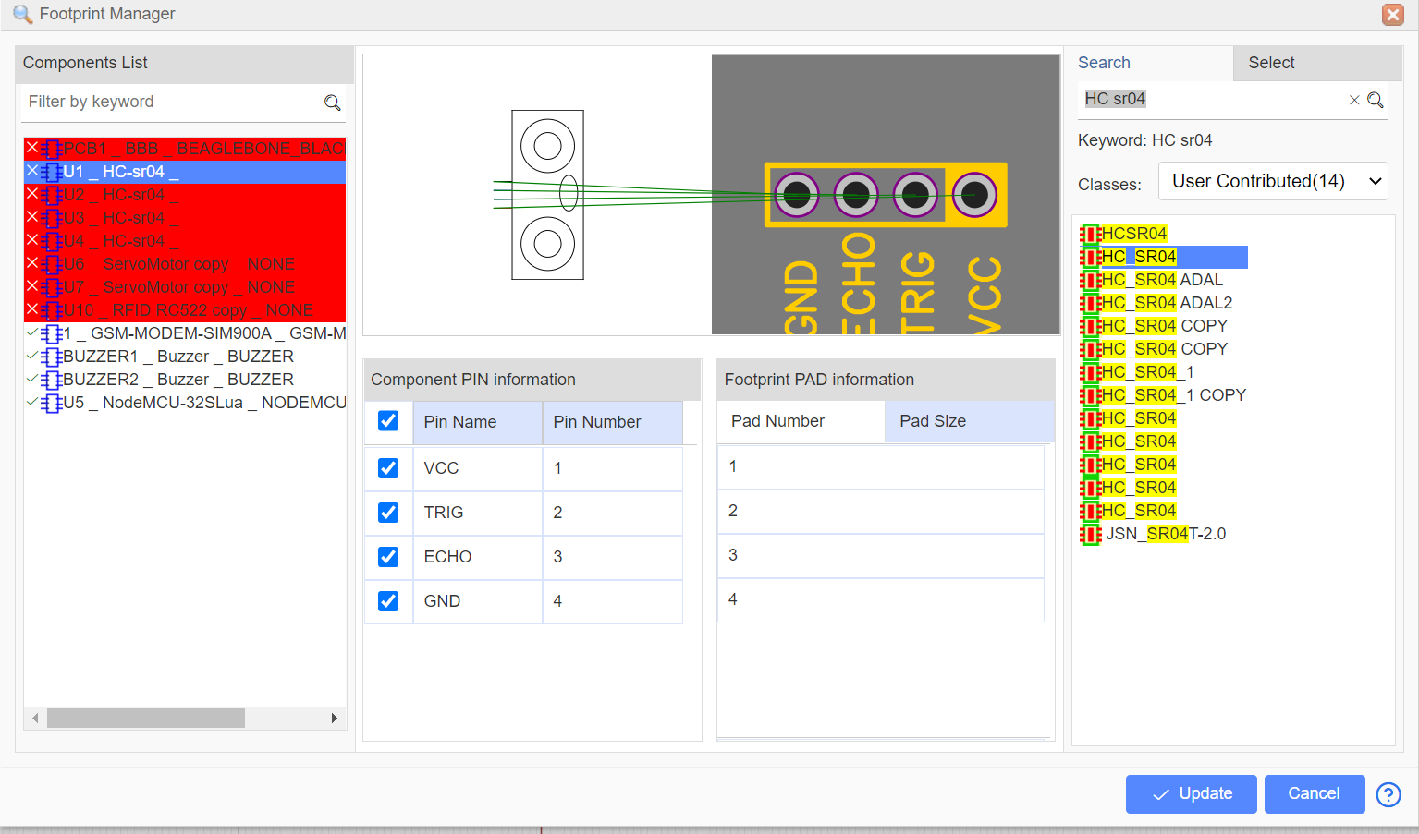
MANIPULATE THE FOOTPRINT

Slide 18
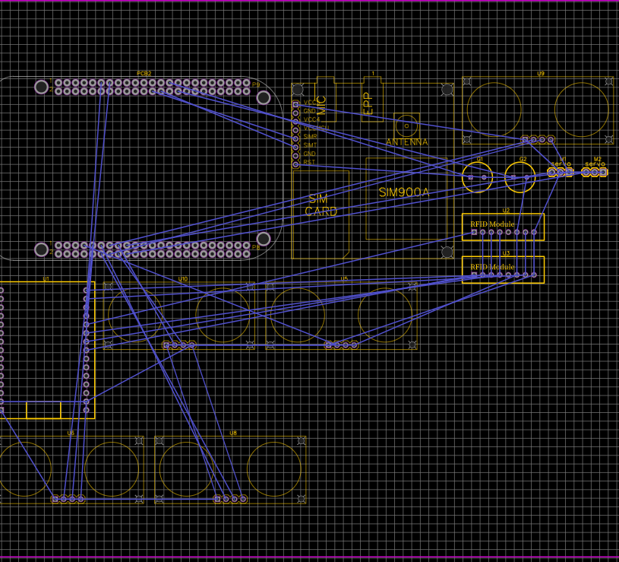
PCB DESIGN BEFORE AUTO ROUTING
The PCB design we get after converting that all the components relate to each other through cress cross wires
We can drag the components anywhere on the grid
To rotate the component use hotkeys R
Customize the track manually or automatically
In auto routing the tracks are made. No two tracks can intersect with each other

Slide 19
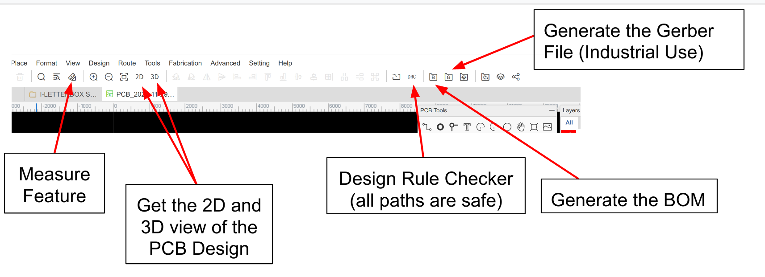
EXPORTING FILES
Once the desired PCB design and routing have made, then we can generate the required files for manufacturing the PCB
After this we could generate the BOM (Bill of Material) and monitor the tracks are proper using the DRC(Design rule check)

Slide 20
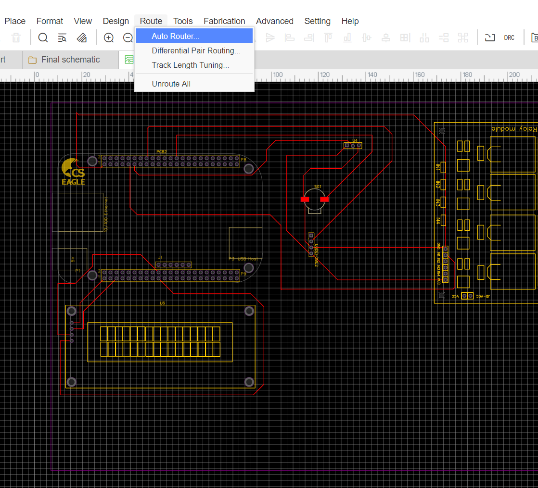
AUTOROUTING
To check the correct clearance between the traces, auto routing can be done after connecting each components
It provides perfect routing of paths and minimizing vias

Slide 21
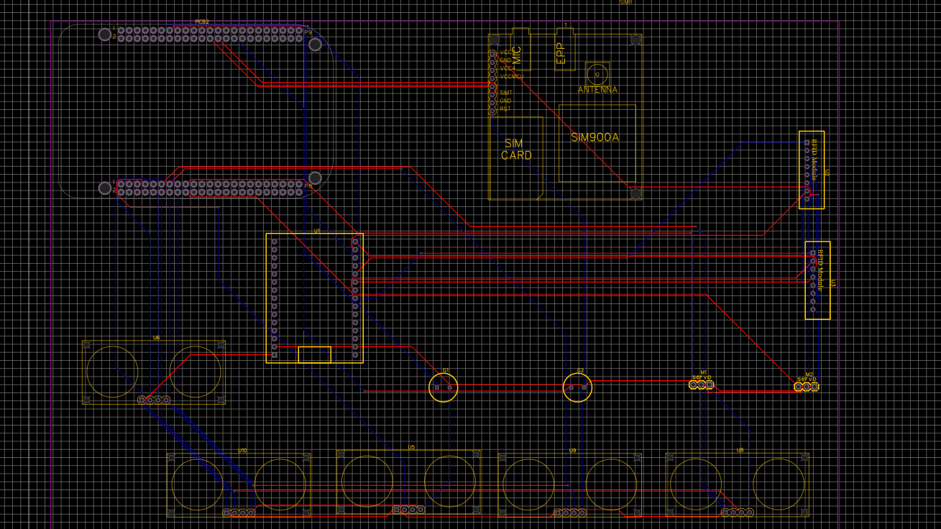
AUTOROUTING

Slide 22
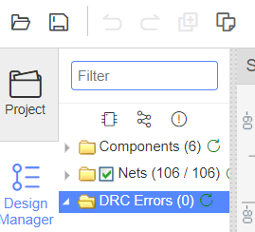
DRC
Design Rule Check helps to find the errors in the traces

Slide 23
GERBER FILE
A Gerber File is a file format used for PCB manufacturing. Fabrication machines, and to layout electrical connections such as trace and pads. The file also contains information for drilling and milling the completed circuit board.
The standard file extension is .GBR though other extensions are also used.
Though the EasyEDA generates the Gerber files but one cannot view it using the same software as it is no longer supported.We needed some third-party software to view the Gerber data. This file helps us to see how the final PCB would look like after manufacture.
It is recommended that we use the gerbv tool, but we can also use the FlatCAM due to other alternatives avaliable we used a web-based tool known as Online Gerber Viewer by PCBway

Slide 24
CONCLUSION
We had different schematics available and had to locate the correct one from 100 of options
Eventually, I resolved the issues and successfully get the desired results
EasyEDA software is very handy tool to design a PCB from the schematic and this is the final step of the project is achieved successfully.
Certain issues of footprint occurred while designing the PCB, but I got the required design and files for manufacturing the PCB

